Slide 1
Association rule mining with FP Growth method
(Frequent Pattern) FP Growth Algorithm

Slide 2
References
Practice this question from this link:
https://www.mygreatlearning.com/blog/understanding-fp-growth-algorithm/
YouTube link of the problem discussed in the slides
https://www.youtube.com/watch?v=ToswH_dA7KU

Slide 3
Finding Frequent Itemsets
Frequent itemsets can be found using two methods, viz Apriori Algorithm and FP growth algorithm.
Apriori algorithm generates all itemsets by scanning the full transactional database. Whereas the FP growth algorithm only generates the frequent itemsets according to the minimum support defined by the user. Since Apriori scans the whole database multiple times, it Is more resource-hungry and the time to generate the association rules increases exponentially with the increase in the database size. On the other hand, the FP growth algorithm doesn’t scan the whole database multiple times and the scanning time increases linearly. Hence, the FP growth algorithm is much faster than the Apriori algorithm.
In apriori algorithm we generate itemsets , and some of the itemsets may not be frequent. Generating all the itemsets is complex. But in FP tree we generate itemsets which are frequent, we don’t generate all itemsets.

Slide 4
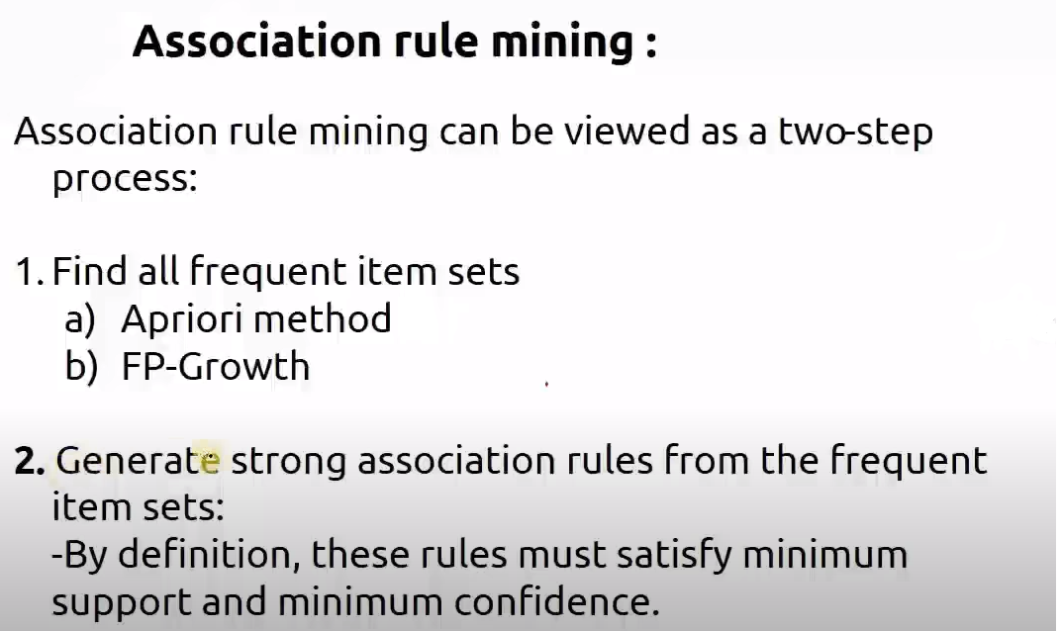

Slide 5
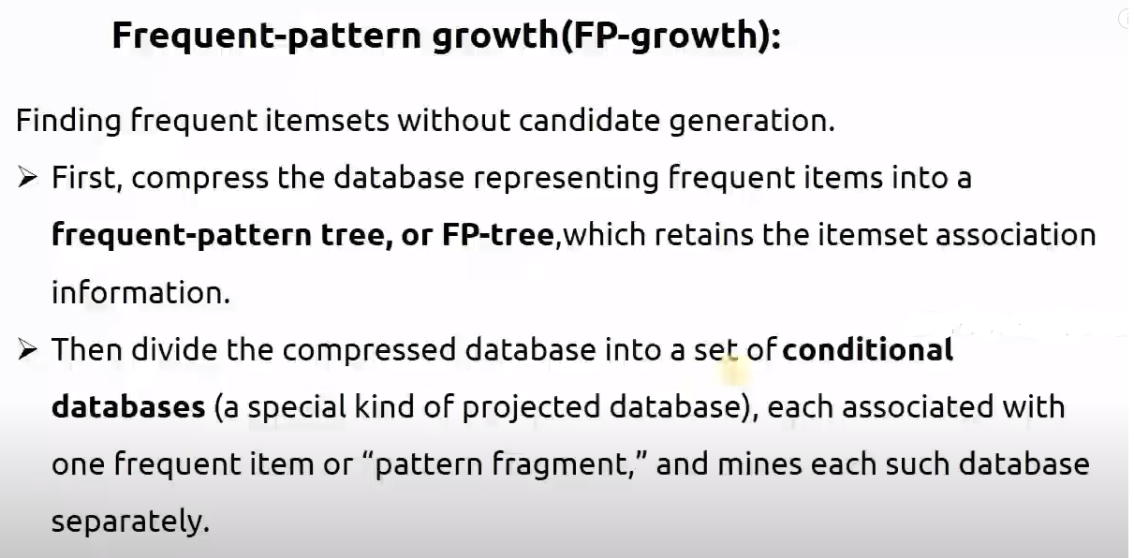

Slide 6
Steps for FP growth Algorithm
#1) The first step is to scan the database to find the occurrences of the itemsets in the database. This step is the same as the first step of Apriori. The count of 1-itemsets in the database is called support count or frequency of 1-itemset.
#2) The second step is to construct the FP tree. For this, create the root of the tree. The root is represented by null.
#3) The next step is to scan the database again and examine the transactions. Examine the first transaction and find out the itemset in it. The itemset with the max count is taken at the top, the next itemset with lower count and so on. It means that the branch of the tree is constructed with transaction itemsets in descending order of count.
#4) The next transaction in the database is examined. The itemsets are ordered in descending order of count. If any itemset of this transaction is already present in another branch (for example in the 1st transaction), then this transaction branch would share a common prefix to the root.
This means that the common itemset is linked to the new node of another itemset in this transaction.
#5) Also, the count of the itemset is incremented as it occurs in the transactions. Both the common node and new node count is increased by 1 as they are created and linked according to transactions.
#6) The next step is to mine the created FP Tree. For this, the lowest node is examined first along with the links of the lowest nodes. The lowest node represents the frequency pattern length 1. From this, traverse the path in the FP Tree. This path or paths are called a conditional pattern base.
Conditional pattern base is a sub-database consisting of prefix paths in the FP tree occurring with the lowest node (suffix).
#7) Construct a Conditional FP Tree, which is formed by a count of itemsets in the path. The itemsets meeting the threshold support are considered in the Conditional FP Tree.
#8) Frequent Patterns are generated from the Conditional FP Tree.

Slide 7
FP-Growth: allows frequent itemset discovery without candidate generation. Two step:
  1.Build a compact data structure called the FP-tree
    2 passes over the database
  2.extracts frequent itemsets directly from the FP-tree
    Traverse through FP-tree

Slide 8
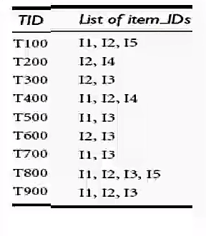
Minimum support count 2
Min confidence 60%
Step 1: determine the support count of itemset of size1, and eliminate the items whose support count is lesser than the min support count.
L1
Items | Support count
{I2} | 7
{I1} | 6
{I3} | 6
{I4} | 2
{I5} | 2
Itemset | Support count
{I1} | 6
{I2} | 7
{I3} | 6
{I4} | 2
{I5} | 2
Step 2: Arrange the items in order of descending order of their support count
Descending Order is I2, I1,I3,I4,I5

Slide 9
Desc order is I2, I1,I3,I4,I5
TID | List of Item_IDs | Arrange in order of descending order of support count
T100 | I1,I2,I5 | I2,I1,I5
T200 | I2,I4 | I2,I4
T300 | I2,I3 | I2,I3
T400 | I1,I2,I4 | I2,I1,I4
T500 | I1,I3 | I1,I3
T600 | I2,I3 | I2,I3
T700 | I1,I3 | I1,I3
T800 | I1,I2,I3,I5 | I2, I1, I3,I5
T900 | I1,I2,I3 | I2,I1,I3
Step 3: Generate FP tree, starting from Null node
Null
Items | Support count | Node link
{I2} | 7
{I1} | 6
{I3} | 6
{I4} | 2
{I5} | 2
I2:7
I1:2
I1:4
I3:2
I4:1
I3:2
I3:2
I5:1
I4:1
Compressing of Conditional DB
Now consider the Transaction T100 it consists of I1,I2,I5. Arrange them in order of descending support i.e. I2,I1,I5. Start from root node and make branch out to node I2,I1,I5.
I5:1

Slide 10
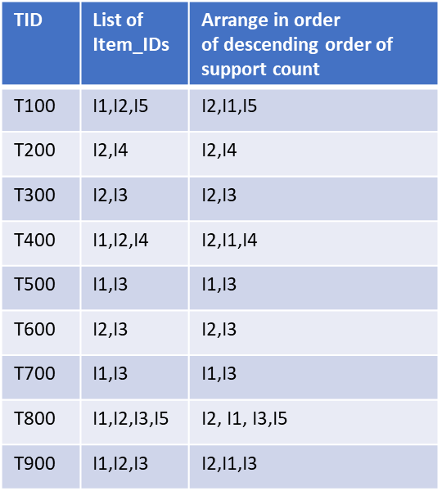
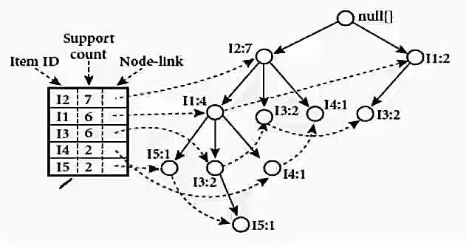
FP tree

Slide 11
Now we need to construct a table for conditional pattern base and hence, the frequent pattern generation. Now let us consider the table in next slide, we need to consider the item which has the lowest support count, here, I5 has the lowest support count of 2. We need to see where the I5 are. We can see there are two traversal paths for I5 from the root node. One of them being I2-I1-I5, where I5 is having count 1 i.e., I5:1. So we can create the conditional pattern base as in Row 1 of the table 4 {I2,I1:1}.
Also, the second traversal path is {I2,I1,I3:I5} and I5 has a count of 1 (I5:1) so the conditional pattern base is {I2,I1,I3:1}. So there are two conditional pattern bases {{I2,I1:1},{I2,I1,I3:1}}.
Similarly do for rest

Slide 12
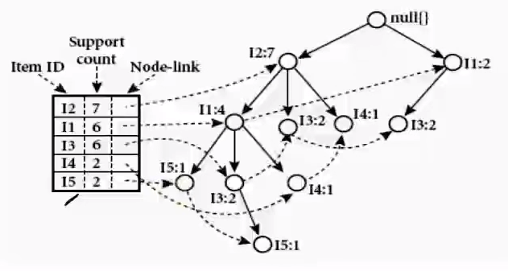
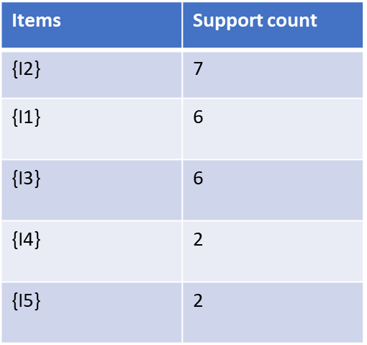
Item | Conditional Pattern Base: the path to desired item from root node | Conditional FP-tree (frequent pattern) | Frequent Pattern generated
I5 | {{I2,I1:1},{I2,I1,I3:1}} | {I2:2, I1:2} | {I2,I5:2}, {I1,I5:2}, {I2,I1,I5:2}
I4 | {{I2,I1:1}, {I2:1}} | {I2:2} | {I2,I4:2}
I3 | {{I2,I1:2},{I2:2},{I1:2}} | {I2:4, I1:2}, {I1:2} | {I2,I3:4},{I1,I3:4}, {I2,I1,I3:2}
I1 | {{I2:4}} | {I2:4} | {I2,I1:4}
I2 | As I2 is directly connected with root Null, ignore this item
Arrange the items in ascending order of support count
FP tree

Slide 13
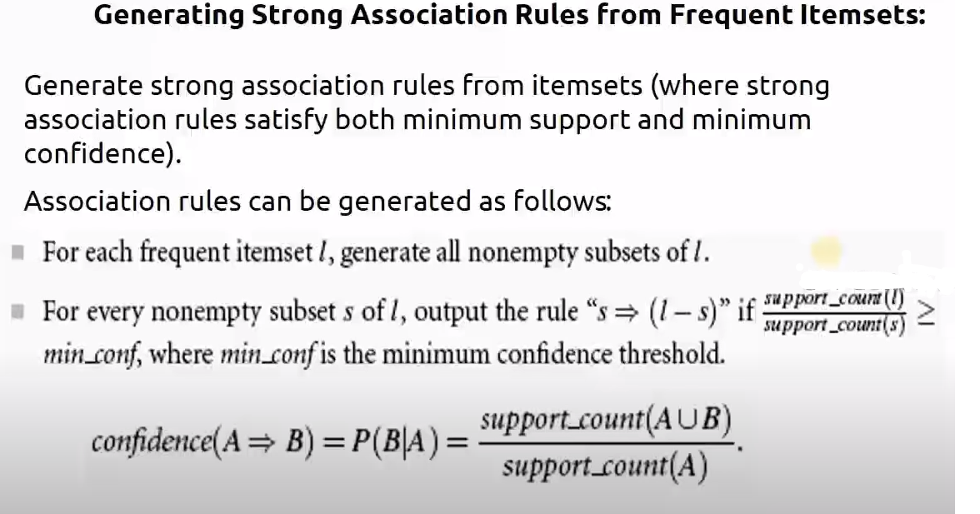

Slide 14
Generate association rules
Suppose I have taken a frequent itemset l as {I2,I1,I5}
Generate its non empty subsets: {I2},{I1},{I5},{I2,I1},{I2,I5},{I1,I5},{I2,I1,I5}
From this suppose i take a subset {I2}
s->l-s
{I2}->{I2,I1,I5}-{I2}
{I2}->{I1, I5}
Calculate the confidence of above rule:
Confidence=2/7*100=28.5%
How many times I2 occurs
How many times I1,I5,I2 occurs all together

Slide 15
Suppose I have taken an frequent itemset l as {I2,I1,I5}
Generate its non empty subsets: {I2},{I1},{I5},{I2,I1},{I2,I5},{I1,I5},{I2,I1,I5}
From this suppose i take a subset {I1}
S->l-s
{I1}->{I2,I1,I5}-{I1}
{I1}->{I2, I5}
Calculate the confidence of above rule:
Confidence=2/6*100=33.3%

Slide 16
Suppose I have taken an frequent itemset l as {I2,I1,I5}
Generate its non empty subsets S: {I2},{I1},{I5},{I2,I1},{I2,I5},{I1,I5},{I2,I1,I5}
From this suppose i take a subset {I5}
S->l-S
{I5}->{I2,I1,I5}-{I5}
{I5}->{I2, I1}
Calculate the confidence of above rule:
Confidence=2/2*100=100%

Slide 17
Suppose I have taken an frequent itemset l as {I2,I1,I5}
Generate its non empty subsets S: {I2},{I1},{I5},{I2,I1},{I2,I5},{I1,I5},{I2,I1,I5}
From this suppose i take a subset {I2,I1}
S->l-s
{I2,I1}->{I2,I1,I5}-{I2,I1}
{I2,I1}->{I5}
Calculate the confidence of above rule:
Confidence=2/4*100=50%

Slide 18
Suppose I have taken an frequent itemset l as {I2,I1,I5}
Generate its non empty subsets S: {I2},{I1},{I5},{I2,I1},{I2,I5},{I1,I5},{I2,I1,I5}
From this suppose i take a subset {I2,I5}
S->l-S
{I2,I5}->{I2,I1,I5}-{I2,I5}
{I2,I5}->{I1}
Calculate the confidence of above rule:
Confidence=2/2*100=100%

Slide 19
Suppose I have taken an frequent itemset l as {I2,I1,I5}
Generate its non empty subsets S: {I2},{I1},{I5},{I2,I1},{I2,I5},{I1,I5},{I2,I1,I5}
From this suppose i take a subset {I1,I5}
S->l-S
{I1,I5}->{I2,I1,I5}-{I1,I5}
{I1,I5}->{I2}
Calculate the confidence of above rule:
Confidence=2/2*100=100%

Slide 20
Suppose I have taken an frequent itemset l as {I2,I1,I5}
Generate its non empty subsets S: {I2},{I1},{I5},{I2,I1},{I2,I5},{I1,I5},{I2,I1,I5}
From this suppose i take a subset {I2,I1,I5}
S->l-S
{I2,I1,I5}->{I2,I1,I5}-{I2,I1,I5}
{I2,I1,I5}->Ø
So ignore this rule

Slide 21
If min confidence is 60 percent select all rules whose confidence came to be 60 percent or more.
The rules are:
{I5}->{I2, I1}
{I2,I5}->{I1}
{I1,I5}->{I2}
Similarly create strong association rules for all the frequent item sets

Slide 22
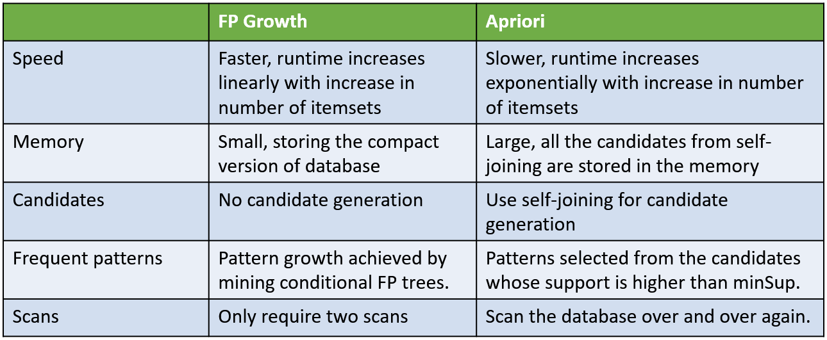
Difference between FP growth and Apriori

Slide 23
Advantages of FP growth algorithm:-
1. Faster than apriori algorithm
2. No candidate generation
3. Only two passes over dataset
Disadvantages of FP growth algorithm:-
1. FP tree may not fit in memory
2. FP tree is expensive to build

Slide 24
Practice this question from this link:
Understanding FP (Frequent Pattern) Growth Algorithm in Data Mining (mygreatlearning.com)
YouTube link of same problem
https://www.youtube.com/watch?v=ToswH_dA7KU

